Slide 1
^{Chapter 6} Graphs
ZAMAN UNIVERSITY
Data Structures and Algorithms

Slide 2
Outline
Terminology and Representations
Graph Traversals
Shortest-Paths Problems
Minimum-Cost Spanning Trees

Slide 3
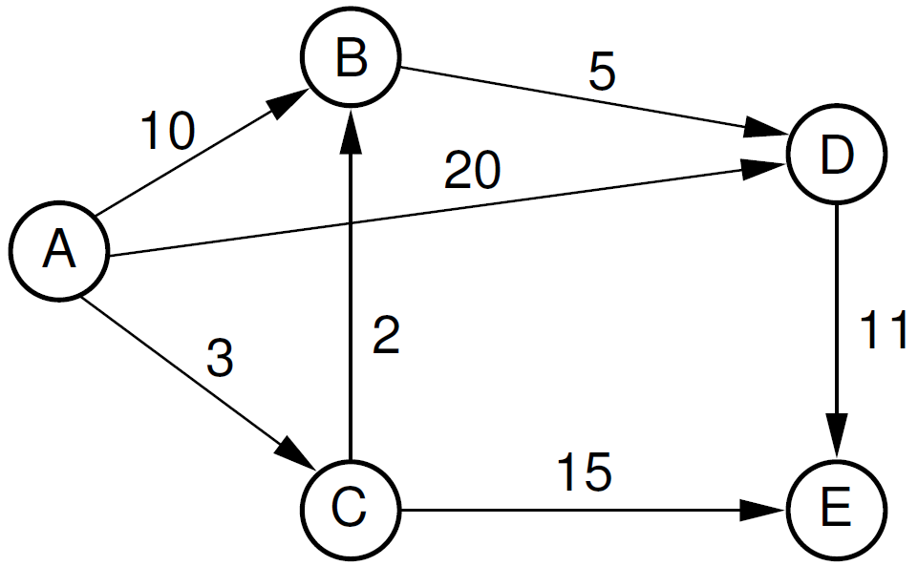
Shortest-Paths Problems
On a road map, a road connecting two towns is typically labeled with its distance (in number)
In graph, the number represents the distance between two vertices
These numbers may be called weights, costs, or distances, depending on the application
Thus, a graph, a typical problem is
to find the total length of the shortest
path between two specified vertices.

Slide 4
Outline
Terminology and Representations
Graph Traversals
Shortest-Paths Problems
Single-Source Shortest Path
Minimum-Cost Spanning Trees

Slide 5
Single-Source Shortest Paths
Single-Source Shortest Paths – sometimes called Dijkstra algorithm
The algorithm is to find shortest paths from s (starting vertex) to every other vertex in G.
It is the worst case, while finding the shortest path from s to t, we might find the shortest paths from s to every other vertex as well.
In computer networks to broadcast a message from a computer to all other computers, the goal is to find the shortest paths from source computer to other.

Slide 6
Dijkstra Algorithm Pseudo-Code
1. function Dijkstra(Graph, s):
2. Create Unvisited List Q = {}
3. for each vertex v in Graph: // Initialization
4. dist[ v ] ← INFINITY // Unknown distance from source to v
5. prev[ v ] ← UNDEFINED // Previous node in optimal path from source
6. add v to Q // All nodes initially in Q (unvisited nodes)
7. dist[ s ] ← 0 // Distance from source to source
8. while Q is NOT empty:
9. u ← vertex in Q with min dist[u] // Source node will be selected first
10. remove u from Q
11. for each neighbor v of u: // where v is still in Q.
12. alt ← dist[u] + length(u, v)
13. if alt < dist[v]: // A shorter path to v has been found
14. dist[v] ← alt
15. prev[v] ← u

Slide 7
Dijkstra Algorithm Animation
https://en.wikipedia.org/wiki/Dijkstra's_algorithm#/media/File:Dijkstra_Animation.gif

Slide 8

8
Write functions of Dijkstra (Single-Source Shortest Paths) base on pseudo-code in the slide.

Slide 9
To be continued…

